Slide 1


SIMATS ENGINEERING
SAVEETHA INSTITUTE OF MEDICAL AND TECHNICAL SCIENCES
“From Caesar to Vigenere: Evolution of Substitution Ciphers”
CSA5108-Cryptography and Network Security
Presented by:
A.Sai Joshitha [192424220]
Guided by:
Jesu Jayarin.P

Slide 2


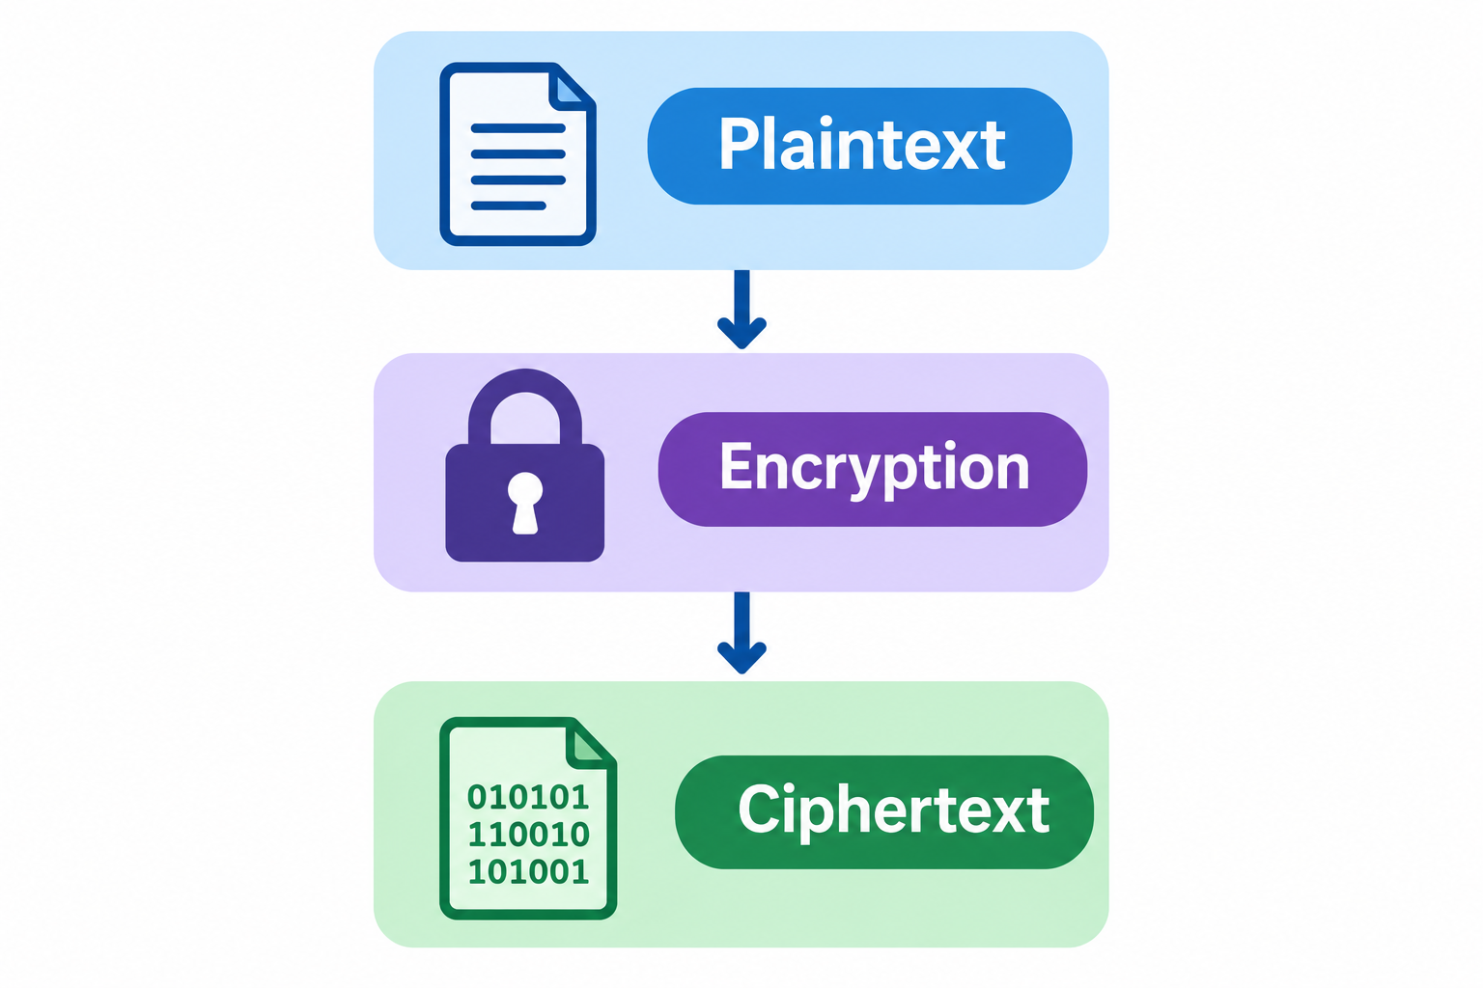
Introduction
What is Cryptography?
Cryptography is the technique of protecting information.
It converts plaintext into ciphertext.
Only the intended receiver should be able to recover the original message.
Substitution ciphers replace plaintext characters with other characters.
Basic process:
Plaintext → Encryption → Ciphertext → Decryption → Plaintext

Slide 3
Caesar Cipher
Caesar Cipher is a substitution cipher.
Each letter is shifted by a fixed number of positions.
The same shift is used for every letter.
Example: Shift = 3
Example:
Plaintext:HELLO
Plaintext | H | E | L | L | O
Shift +3 | K | H | O | O | R
Ciphertext | K | H | O | O | R
Result:HELLO → KHOOR

Slide 4
Weakness of Caesar Cipher
Only 25 possible keys
Easy to break using brute-force attack
Same shift is used for every letter
Letter patterns remain unchanged
Therefore, it provides low security
Example of Brute-Force Attack
If the ciphertext is:
KHOOR
An attacker can try:
Shift 1 → JGNNQ
Shift 2 → IFMMP
Shift 3 → HELLO ✓
So, the correct message can be found easily.

Slide 5
Monoalphabetic Substitution
Each plaintext letter is replaced by one fixed ciphertext letter.
The same substitution is used throughout the message.
It is more complex than the Caesar Cipher.
It can still be broken using frequency analysis.
Simple Example
Suppose the substitution is:
So:
A → Q
B → W
C → E
D → R
E → T
Example
If:
HELLO → ITSSG
The same letter always gets the same replacement.
For example:
L → S every time.
Plaintext | A | B | C | D | E
Ciphertext | Q | W | E | R | T

Slide 6
Vigenere Cipher
Vigenère Cipher is a polyalphabetic substitution cipher.
It uses a keyword for encryption.
Different letters can use different shifts.
It is more secure than Caesar and Monoalphabetic ciphers.
Example:
Plaintext: ATTACK
Key: LEMONL
Ciphertext: LXFOPV
Plaintext | A | T | T | A | C | K
Key | L | E | M | O | N | L
Ciphertext | L | X | F | O | P | V
Result:ATTACK + LEMONL → LXFOPV

Slide 7
Comparison of Substitution Ciphers
Feature | Caesar | Monoalphabetic | Vigenere
Method | Fixed shift | Fixed mapping | Keyword-based
Security | Low | Medium | Higher
Key | Single shift | Letter mapping | Keyword
Main weakness | Brute force | Frequency analysis | Repeated-key analysis

Slide 8
Conclusion
Caesar Cipher is simple but weak.
Monoalphabetic Cipher provides better substitution but is vulnerable to frequency analysis.
Vigenère Cipher uses multiple substitution alphabets.
Vigenère provides better security than Caesar and Monoalphabetic ciphers.
The evolution shows the improvement of cryptographic techniques.

Slide 9


